Slide 1
Cross Border Education
SEAMEO Centres Best Practices
Dr. Gatot Hari Priowirjanto
SEAMEO Secretariat Director
Presented at Tsukuba University
February 12, 2016

Slide 2
Promoting early childhood care and education
Addressing barriers to inclusion and
Preparing schools leaders, teachers, students and local communities towards resiliency in the face of emergencies
Promoting technical and vocational education and training (TVET) among learners and their parents
Reforming teacher education and make teaching profession a first choice
Harmonizing higher education and research
Adopting a truly 21st century curriculum
"Cross-border tertiary education refers to the movement of people, programmes, providers, curricula, projects, research and services in tertiary (or higher) education across national jurisdictional borders." (OECD and World Bank (2002)).
“Cross-border education refers to the movement of people, programs, providers, knowledge, ideas, projects and services across national boundaries." (Knight, J. (2005)

Slide 3
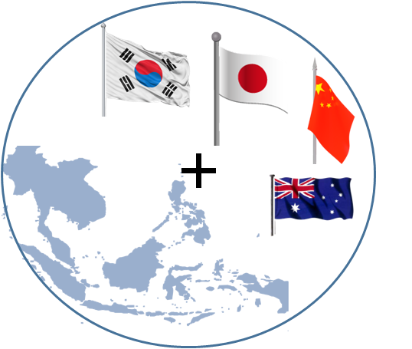
Cross Border Education SEAMEO Centres Best Practices
Online Test/Exercise
Online Seminar
Teacher & Student Mobility
Online Training
E-Collaborative Learning
Teacher Attachment program
Internship Program
Student exchange
Online Lecture
Content Mobility

Slide 4
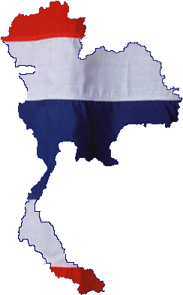
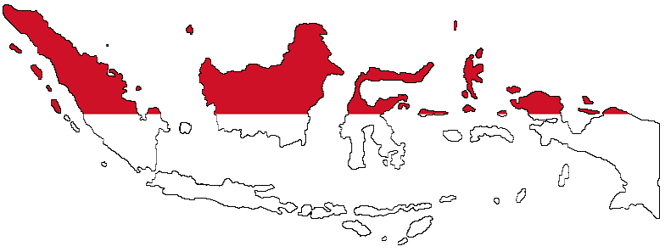
Exchange of Pre-Service Teacher Education Students in SEA for Practicum
English
Science
Math
Valaya Alongkorn Rajabhat University (VRU) | 10 Students
Makassar State University (UNM) | 12 Students
Batch 1
20 Jan-18 Feb 2016
Evaluation meeting & Batch 2 preparation
26-27 February at VRU Campus
1st week – Class observation
2nd week – Teaching assistant
3rd week – Teaching in classroom
4th week – Reflection and lesson learned
Reporting, reflection and lesson learned by student blog
http://seateacher.seameo.org

Slide 5
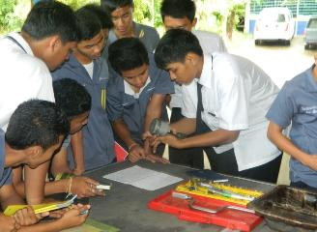
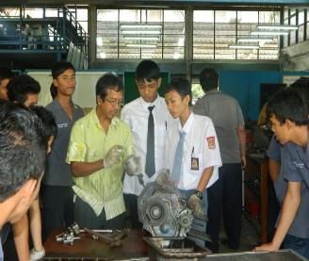
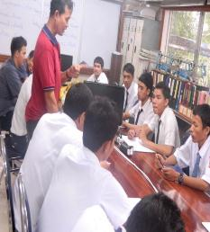
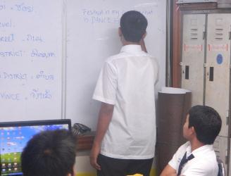
5 batches Indonesia-Thailand Vocational Partnership – more than 250 students exchanged (2010-2015)

Slide 6
Vocational Partnership 2010-2015
23 Indonesia Vocational Institutions
27 Thailand Colleges
2010
2011
2012
2013
2014-2015
36 Indonesia Vocational Institutions
38 Thailand Colleges
27 Indonesia Vocational Institutions
35 Thailand Colleges
19 Indonesia Vocational Institutions
31 Thailand Colleges
20 Indonesia Vocational Institutions
19 Thailand Colleges

Slide 7
Activities 2010-2015
Teacher and Student Camp
Sit in classroom
Mobile Learning/Digital Class
Cross Country On Job Training
2010
2011
2012
2013
2014-2015
Teacher and Student Camp
Short term sit in classroom
Collaborative e-learning
Teacher and Student Camp
Short term sit in classroom
English Cyber Class
Teacher and Student Camp
Short term sit in classroom
Collaborative e-learning
Teacher and Student Camp

Slide 8
SEA-TVET Consortium
TVET Institutions,
Policy Makers
Private and Industrial Sector
Development Agencies in the region and beyond
Student exchange (cultural mutual understanding)
Sit-in classroom program
Internship exchange in industry
Teacher exchange
http://seatvet.seameo.org

Slide 9
SEA-Language Program
In cooperation with Centre for Development and
Strategy of Language Diplomacy, Language Board
Ministry of Education and Culture, Indonesia
Teacher requirements:
Advanced skills in teaching Indonesia Language for Foreigner
Advanced skills in English for communication
Advanced skills in IT (SEA Digital Class Competencies):
Edmodo as Social Learning Network platform
Developing Digital Book
Optimizing communication tools for coordinating and developing cooperation (Watsapp, Line, Webex, Facebook)
provides an opportunity for Indonesian teachers to teach the Indonesian language for foreigner particularly for teachers and students in the college, as well as to integrate ICT into teaching and learning activities.
Countries | Number of Indonesia Teachers Sent
 | 2016 | 2017 | 2018 | 2019
Brunei | 1 | 1 | 1 | 1
Cambodia | 5 | 5 | 5 | 5
Lao | 2 | 2 | 2 | 2
Malaysia | 2 | 2 | 2 | 2
Myanmar | 4 | 4 | 4 | 4
Philippines | 7 | 7 | 7 | 7
Thailand | 20 | 20 | 20 | 20
Vietnam | 5 | 5 | 5 | 5
Singapore | 2 | 2 | 2 | 2
Timor Leste | 3 | 3 | 3 | 3

Slide 10
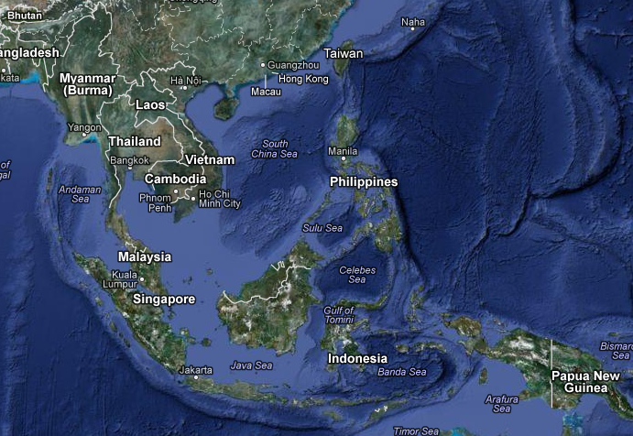
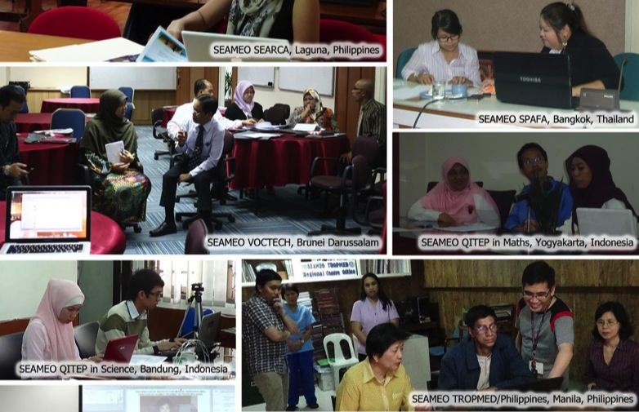
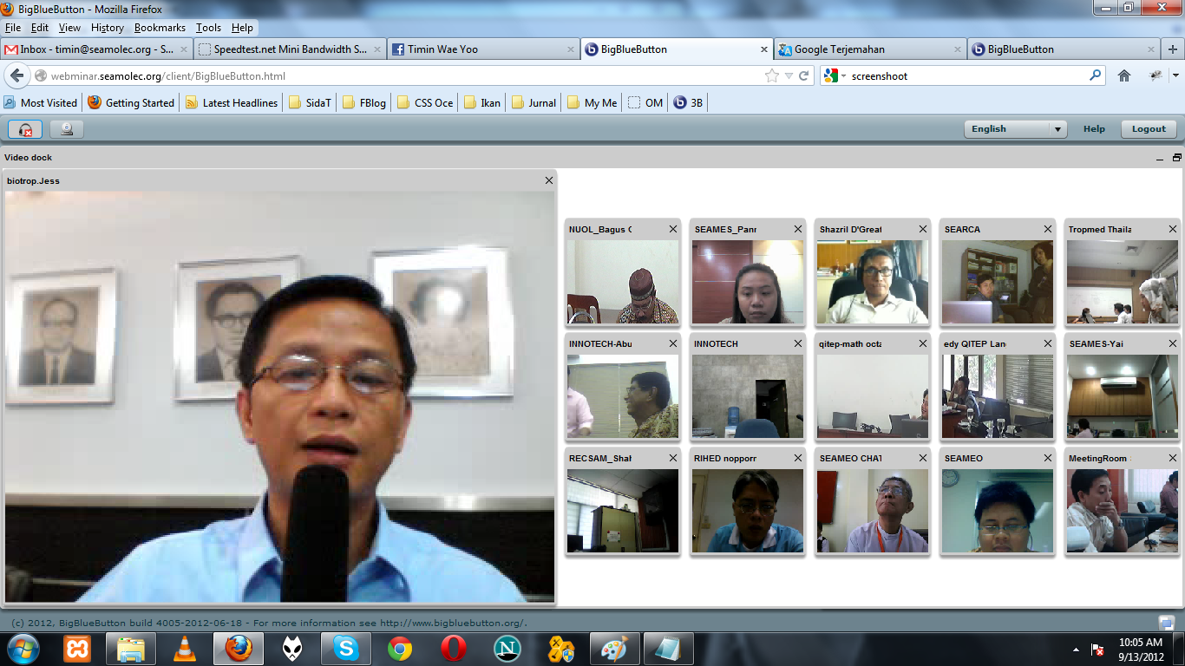
Online Seminar, Meeting and Lecture
Collaboration 21 SEAMEO Centres

Slide 11
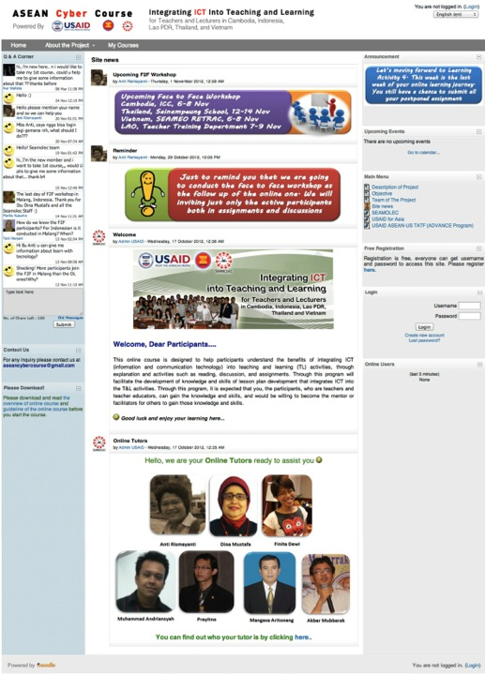
Go Massive Open Online Course
On line training and education, information, leisure, communication, collaboration, find resources, etc

Slide 12
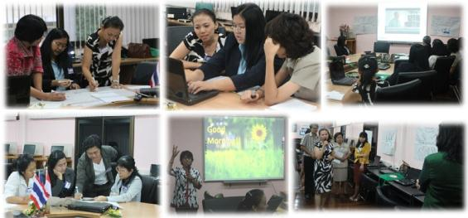
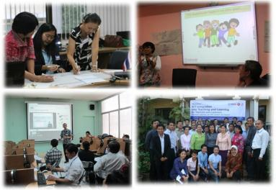
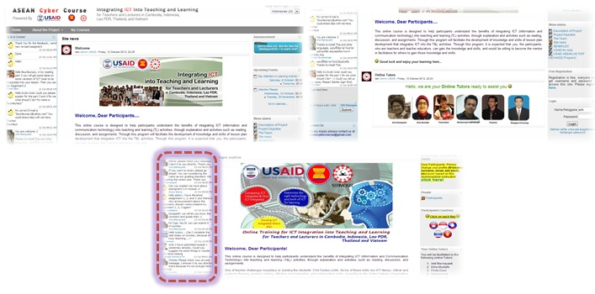
Online & F2F Activities

Slide 13
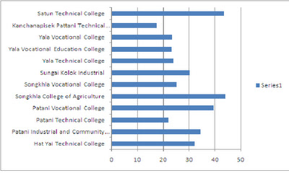
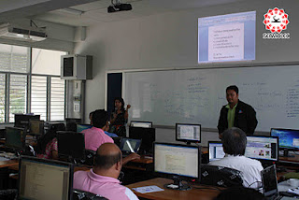
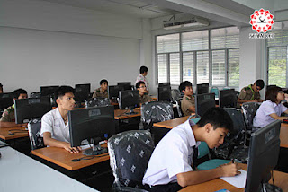
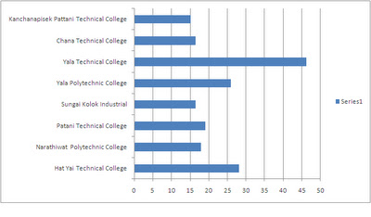
Vocational Online Test
Basic Computer
SMK 2 Depok, Jogyakarta, Indonesia
VS
Hatyai Technical College, Thailand
Direct Current Circuit
http://thailandseacyberclass.blogspot.com/

Slide 14
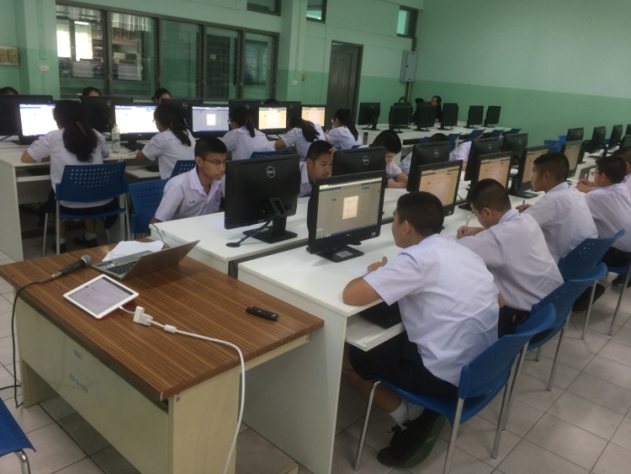
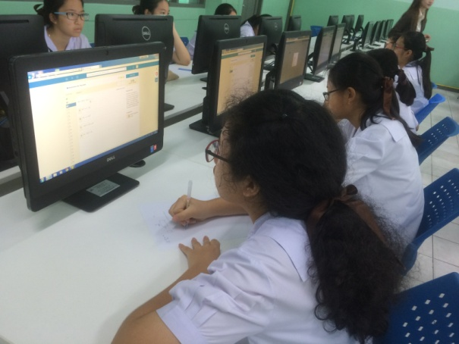
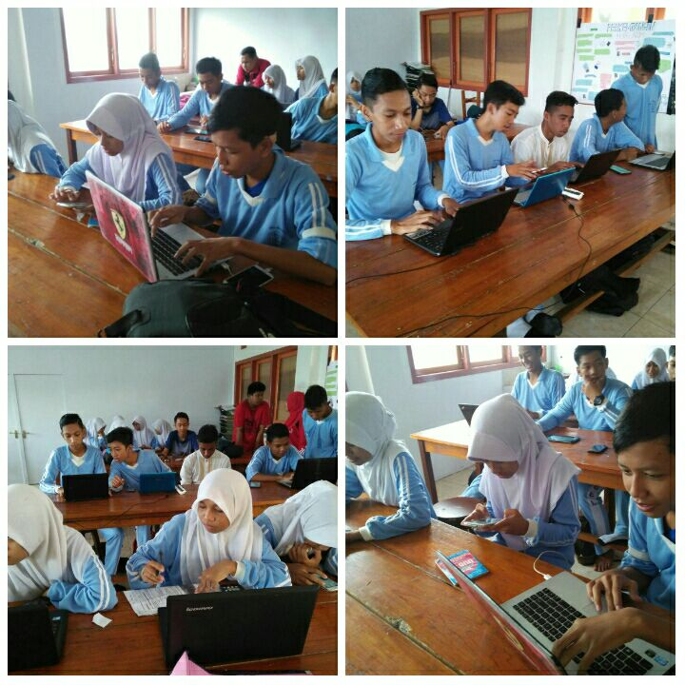
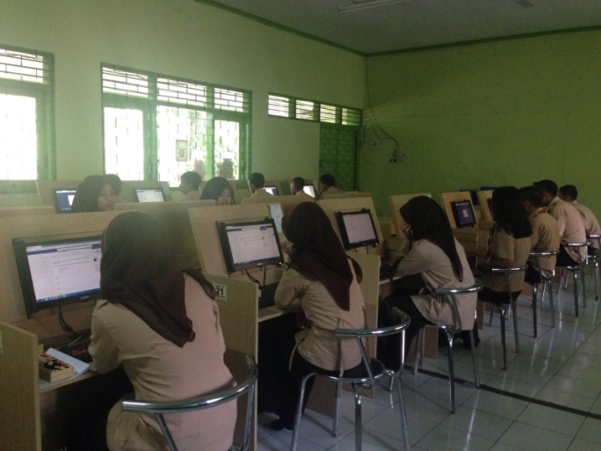
Science & Math Online Test
35 Primary Schools
15 Lower Secondary Schools
>70
Brunei, Cambodia, Indonesia, Lao PDR, Malaysia, Myanmar, Philipines, Thailand, Timor Leste, Vietnam
50-70
<50

Slide 15
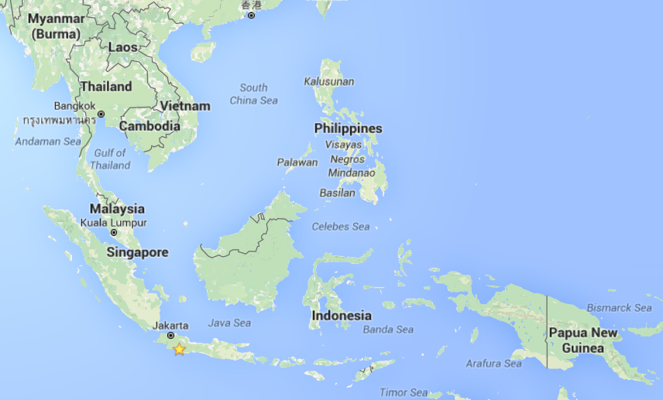
Online Test Collaboration between Indonesian and Vietnamese Primary School

Slide 16
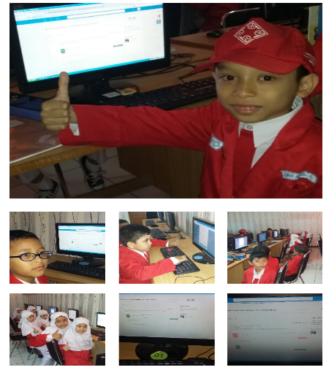
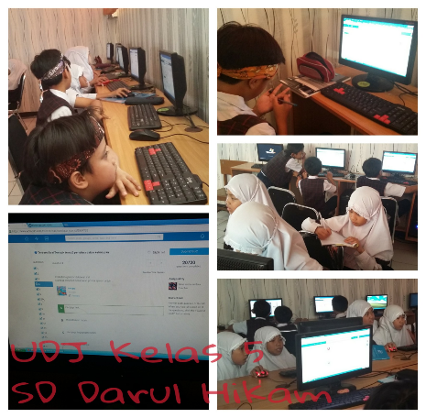
Implementation Online Test Collaboration between Indonesian and Vietnamese Primary School

Slide 17
Data of Indonesian School doing Online Test on Edmodo Period of Feb 2016 with Doan Thi Diem School Hanoi
Level | Total of Indonesia Provinces | Total of Students
Primary School (SD) 4th Grade | 12 | 815
Primary School (SD) 5th Grade | 10 | 967
Primary School (SD) 6th Grade | 10 | 949
Total |  | 2731

Slide 18
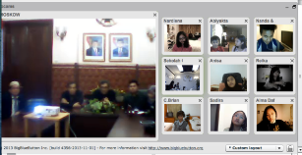
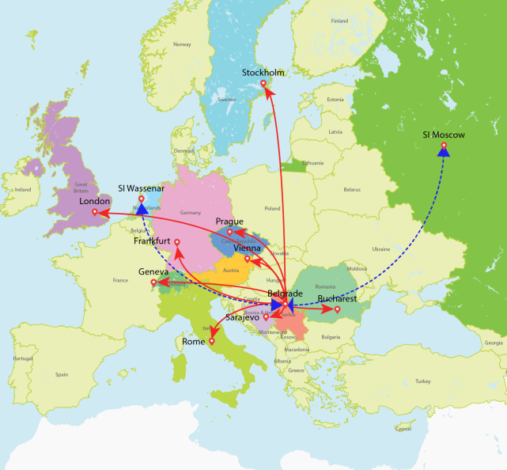
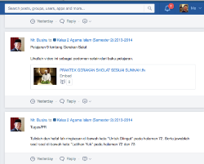
Online Distance Education for Indonesian Students out of Belgrade
Online Lecturing
Video Lecturing
Web-based learning activities

Slide 19
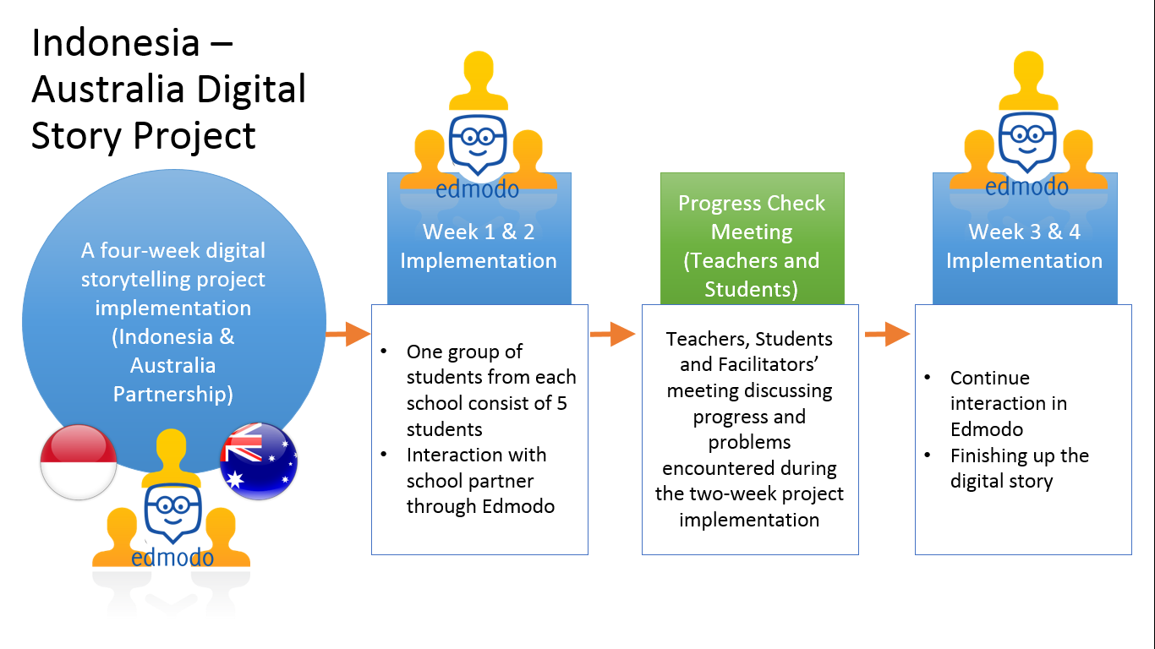
Indonesia-Australia Mobility

Slide 20
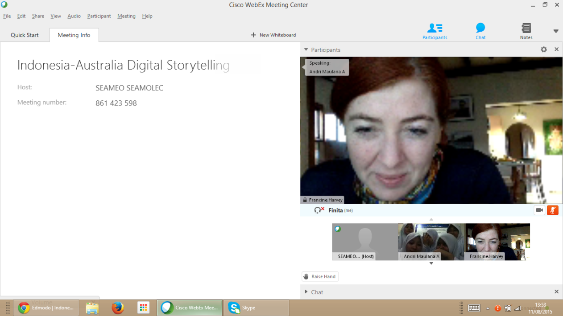
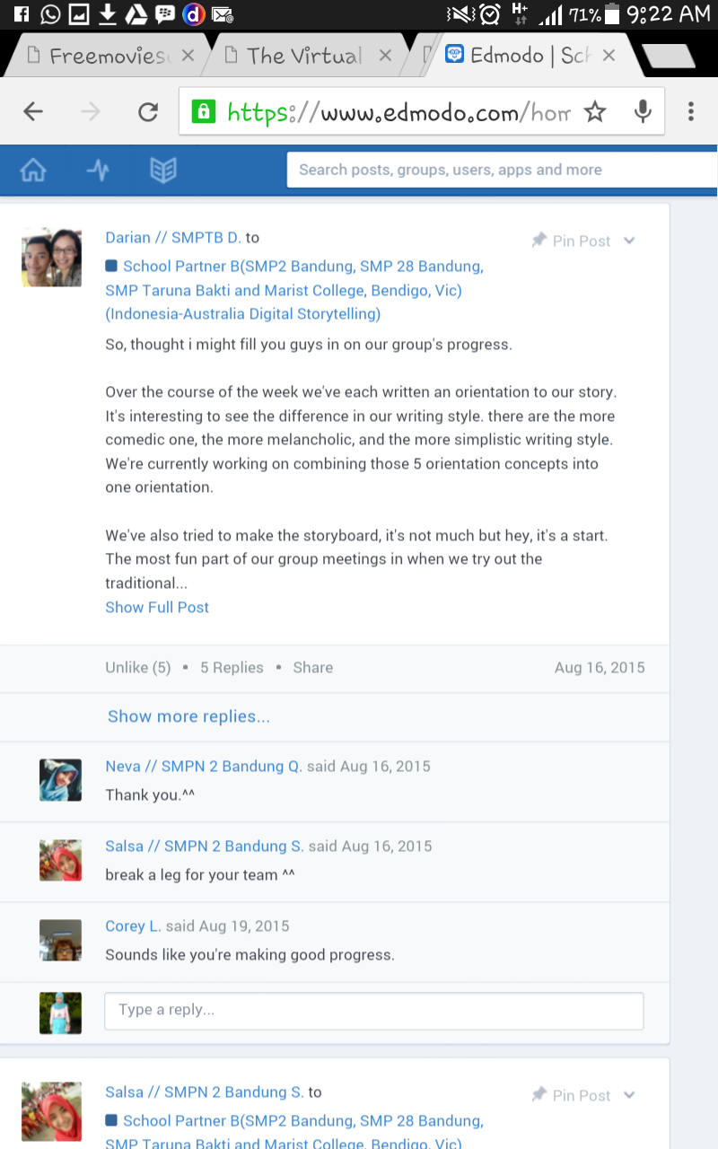
Screenshot from edmodo & webex Indo-Aus interaction

Slide 21
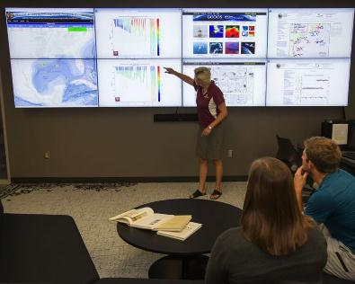
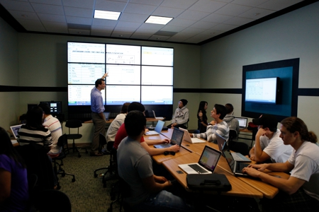
Upcoming Program: eTwinning Class
Among provinces
Among countries
- Video wall technology
- Collaborate on the internet
- Fostering human contact and cultural links
Benefit:
Capacity building
Identification of best practice
Added value, increased quality & effectiveness of school activities
Broadening of horizons
Relationship building
Networking
Mobility teachers and learners

Slide 22
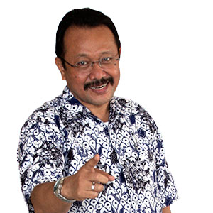
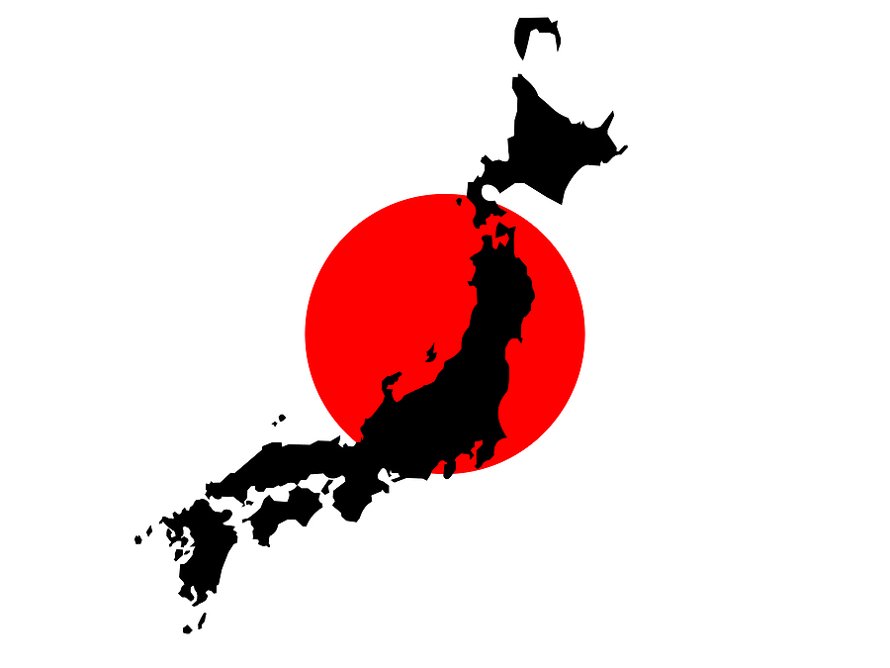
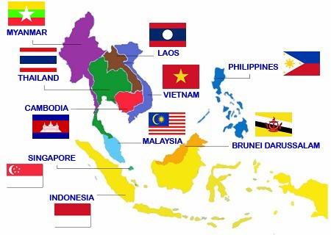
Thank You……. Any question???
Near future dream……
gatot@seameo.org

